Slide 1

Chapter 4
Gates and Circuits

Slide 2
Chapter Goals
Identify the basic gates and describe the behavior of each
Describe how gates are implemented using transistors
Combine basic gates into circuits
Describe the behavior of a gate or circuit using Boolean expressions, truth tables, and logic diagrams

Slide 3
Computers and Electricity
Gate
A device that performs a basic operation on
electrical signals
Circuits
Gates combined to perform more
complicated tasks

Slide 4
Computers and Electricity
How do we describe the behavior of gates and circuits?
Boolean expressions
Uses Boolean algebra, a mathematical notation for expressing two-valued logic
Logic diagrams
A graphical representation of a circuit; each gate has its
own symbol
Truth tables
A table showing all possible input value and the associated
output values

Slide 5
Gates
Six types of gates
  NOT
  AND
  OR
  XOR
  NAND
  NOR
Typically, logic diagrams are black and white with gates distinguished only by their shape
We use color for emphasis (and fun)

Slide 6
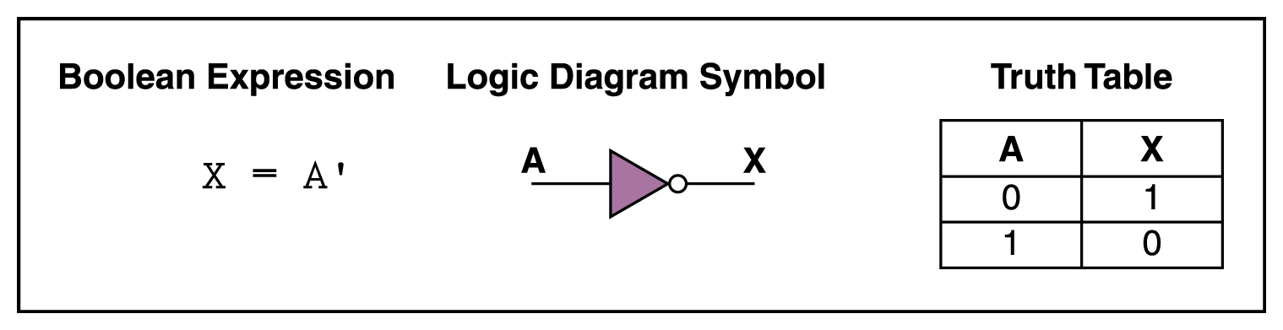
NOT Gate
A NOT gate accepts one input signal (0 or 1) and returns the opposite signal as output
Figure 4.1 Various representations of a NOT gate

Slide 7
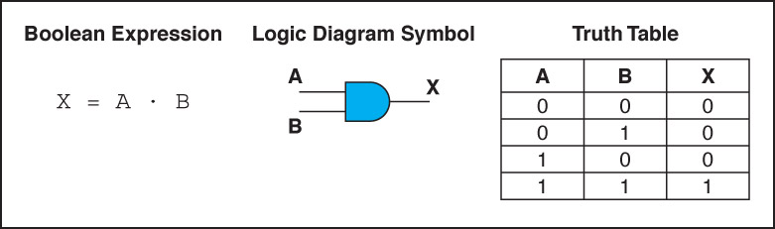
AND Gate
An AND gate accepts two input signals
If both are 1, the output is 1; otherwise,
the output is 0
Figure 4.2 Various representations of an AND gate

Slide 8
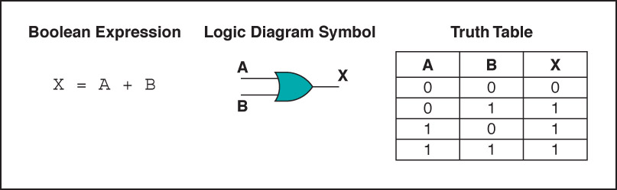
OR Gate
An OR gate accepts two input signals
If both are 0, the output is 0; otherwise,
the output is 1
Figure 4.3 Various representations of a OR gate

Slide 9
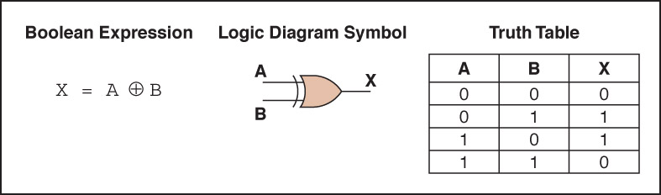
XOR Gate
An XOR gate accepts two input signals
If both are the same, the output is 0; otherwise,
the output is 1
Figure 4.4 Various representations of an XOR gate

Slide 10
XOR Gate
Note the difference between the XOR gate
and the OR gate; they differ only in one
input situation
When both input signals are 1, the OR gate produces a 1 and the XOR produces a 0
XOR is called the exclusive OR

Slide 11
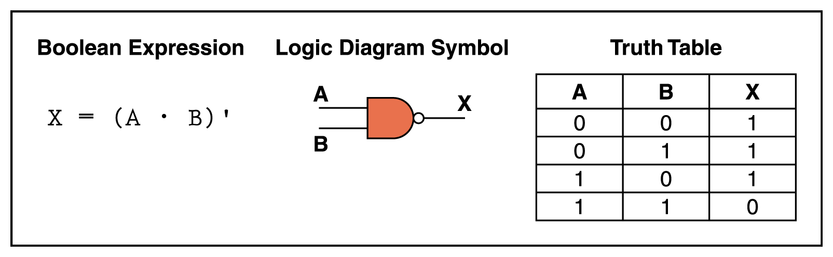
NAND Gate
The NAND gate accepts two input signals
If both are 1, the output is 0; otherwise,
the output is 1
Figure 4.5 Various representations of a NAND gate

Slide 12
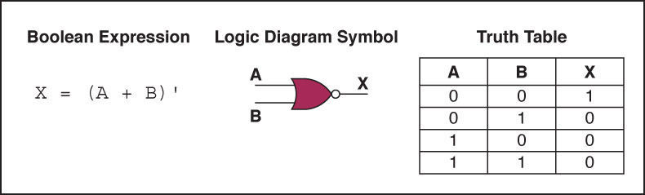
NOR Gate
The NOR gate accepts two input signals
If both are 0, the output is 1; otherwise,
the output is 0
Figure 4.6 Various representations of a NOR gate

Slide 13
Review of Gate Processing
A NOT gate inverts its single input
An AND gate produces 1 if both input values are 1
An OR gate produces 0 if both input values are 0
An XOR gate produces 0 if input values are the same
A NAND gate produces 0 if both inputs are 1
A NOR gate produces a 1 if both inputs are 0

